Slide 1
How to Drive Sales in a Services Business
Subscribe: intelliven.com
Follow: IntelliVen on LinkedIn
Copyright 2022 IntelliVen, LLC
Notes:
Members https://intelliven.com/wp-content/uploads/2022/03/MtL-Workshop-Loris-CEO-Group-v4.pdf In our upcoming meeting, Professional CEO, Peter DiGiammarino, founder and managing partner of IntellIVen, will lead us in a ~90-minute workshop on how a leader and their team can perform better and grow faster by getting aligned on WHAT their organization provides, to WHOm, and WHY customers decide to purchase from the organization.
To get the most out of the workshop, please:
• Watch this ~5-minute Get Clear video that sets the stage
• Fill out this WHAT-WHO-WHY Template with your own organization in mind.
If you would like, for an even richer experience, you are welcome to pass on the above instructions to your top team members to follow on their own, without collaborating with you or each other!

Slide 2
Sales Roles in a Services Practice
The different roles required to drive revenue growth in a services firm each require specific skills and orientations.
The roles often get combined in awkward ways which lead to suboptimal results.
These slides present a framework for the various roles according to what each gets done and how performance is measured.
Be careful when combining roles because most people perform distinctly better at one than the others.

Slide 3
A new sale creates the opportunity to deliver services.
Sales
Project
Management
PERFORMANCE GOAL:
Deliver on-time, on-budget, and on target
New
Business
Development
Sell a project to
a new client
Time

Slide 4
Extend and Expand the Opportunity to Deliver Even More Value
Expand
Sales
Extend
PERFORMANCE GOALS:
Deliver on time, on budget, and on target
Find and develop ways to deliver greater value making the engagement larger and longer
Project
Management
Time

Slide 5
Account Development
Find New Work
Nearby
Sales
Account
Development
PERFORMANCE GOAL:
Use presence on a project as a platform
to find and develop ways to deliver
value in other parts of the same organization in ways that, ideally, can be turned into an offering to other clients.
Time

Slide 6
Solution Sales
Sales
Package what was done successfully for one organization and use it as a door-opener with another organization
Time
Solution
Offering
Management

Slide 7
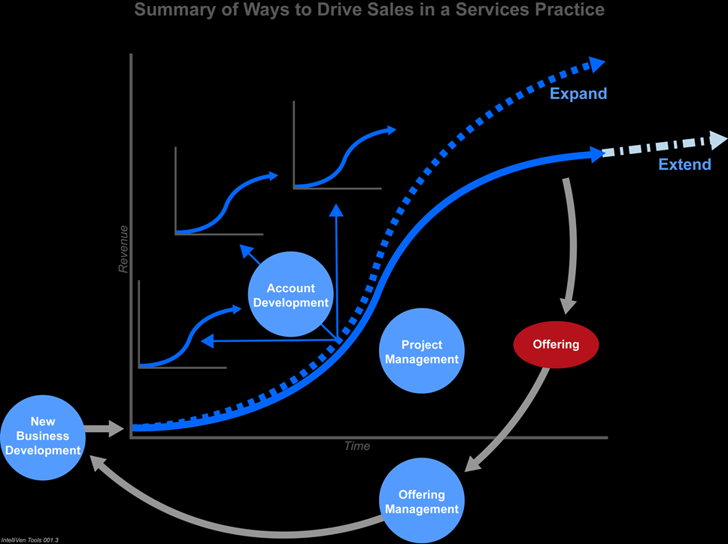
Summary of ways to drive sales in a service business
Summary of Ways to Drive Revenue is a Services Practice

Slide 8
Distinct Roles Breadth of skills required drives individuals to perform best in one of these specific roles.
Role | Description | Performance Metrics
Salesman | Finds and cultivates prospects through to closed sales. | New account sales relative to quota.
Project Manager | Manages assigned resources to complete contracted work on time, on target, on budget. | Client reference; financial targets achieved; extend and expand engagement to deliver even more value to existing customer relative to a plan.
Account Manager | Finds and cultivates opportunities to deliver more value in other parts of client organization. | New work in other parts of the organization being served that, ideally, can be turned into an offering to other clients.
Offering Manager | Collects, consolidates, and disseminates lessons learned; drives offering development in response to customer needs, competition, and technology. | Customer retention, growth in revenue connected to offering, and indirect expenses all in-line with plan.
Unit Manager | Sets and achieves a plan to perform and grow revenue across clients in a market. | Contribution to corporate profit net of all direct and indirect costs including bonus awards.

Slide 9
Resources Contact: intelliven@intelliven.com
Free
IntelliVen blog
Follow @intelliven
Select tools, insights, videos, and presentations
Course syllabus, reading list, windows-of-time
Fee-based
Board-in-a-Box
Management Team Workshops
Executive Performance Assessment
Strategy Development
Initiative-to-Action
Contracting and Governance
Manage to Lead Workbook
Executive Training
Executive Coaching

Slide 10
Thank you.
Subscribe: intelliven.com
Follow: IntelliVen on LinkedIn
Notes:
2:55
FEEDBACK SURVEY: https://docs.google.com/forms/d/e/1FAIpQLSdzyc5dD99sAl88pX7ZJe4nScqybFwbIWJgphUBft3q73mKQw/viewform?usp=sf_link
SUBSCRIBE TO INTELLIVEN: https://mailchi.mp/intelliven/join
FOLLOW INTELLIVEN ON LIKEDIN: https://www.linkedin.com/company/intelliven-l-l-c-/?viewAsMember=true

